Slide 1
Chapter 13: Usability
People ignore design that ignores people.
—Frank Chimero

Slide 2
Chapter Outline
What is Usability?
Usability General Scenario
Tactics for Usability
Tactics-Based Questionnaire for Usability
Patterns for Usability
Summary

Slide 3
What is Usability?
Usability is concerned with how easy it is for the user to accomplish a desired task and the kind of user support that the system provides.
Usability comprises the following areas:
Learning system features
Using a system efficiently
Minimizing the impact of user errors
Adapting the system to user needs
Increasing confidence and satisfaction

Slide 4
What is Usability?
There is a strong connection between the achievement of usability and modifiability.
The user interface design process consists of generating and then testing a user interface design.
It is highly unlikely that you will get this right the first time, so you should plan to iterate this process—and hence you should design your architecture to make that iteration less painful.

Slide 5
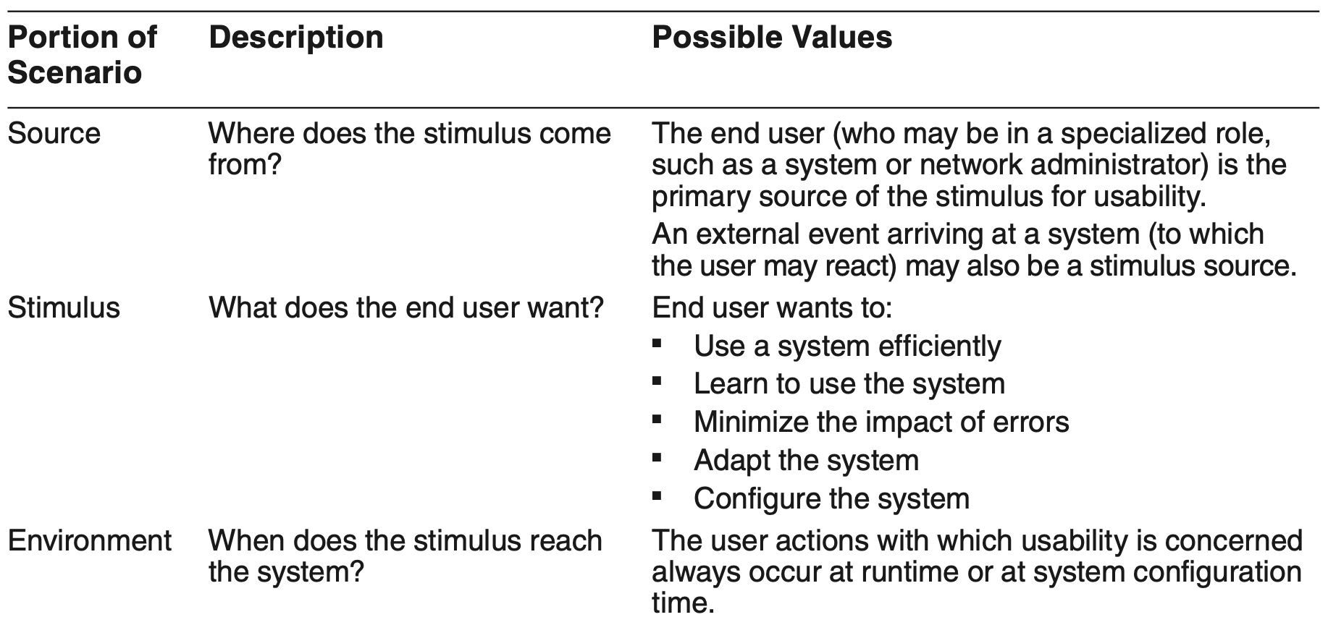
Usability General Scenario

Slide 6

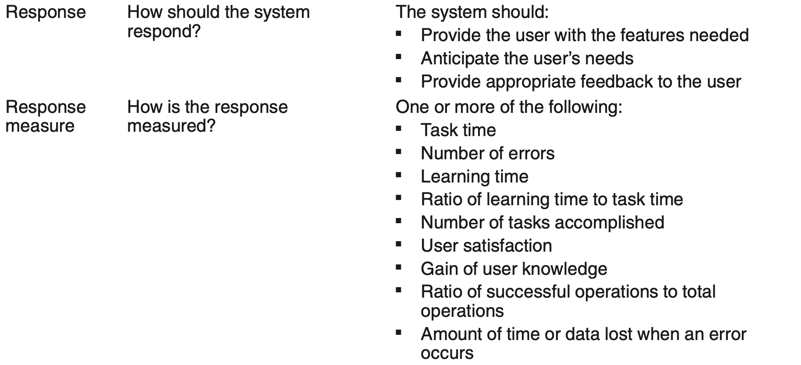
Usability General Scenario

Slide 7
Sample Concrete Usability Scenario
The user downloads a new application and is using it productively after 2 minutes of experimentation.

Slide 8
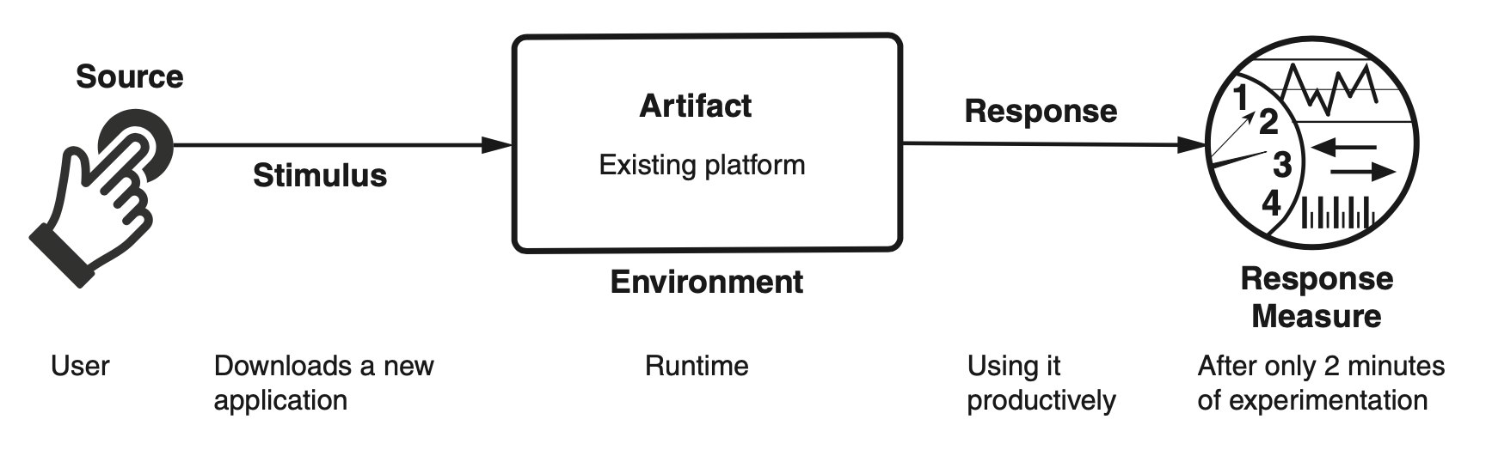
Sample Concrete Usability Scenario

Slide 9
Goal of Usability Tactics
There are two categories of tactics for Usability:
The first category deals with supporting user initiative.
The second deals with supporting system initiative.

Slide 10
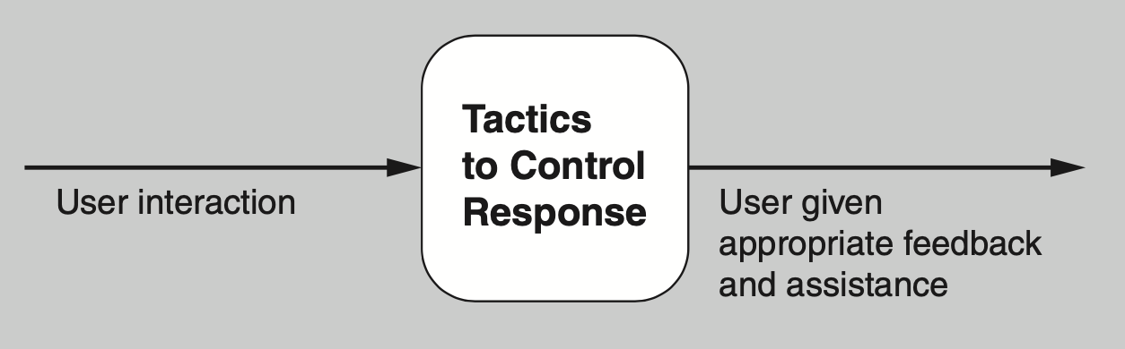
Goal of Usability Tactics

Slide 11
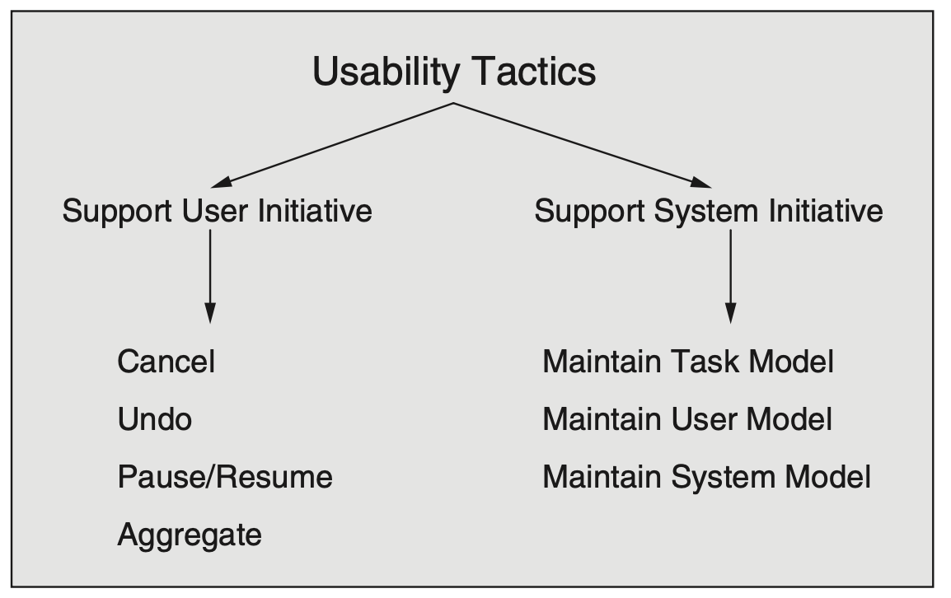
Usability Tactics

Slide 12
Support User Initiative
Cancel. When the user issues a cancel command, the system must be listening for it; the activity being canceled must be terminated; resources being used by the canceled activity must be freed; and components that are collaborating with the canceled activity must be informed so that they can also take appropriate action.
Undo. To support the ability to undo, the system must maintain enough information about system state so that an earlier state may be restored, at the user’s request.
Pause/resume. When a user has initiated a long-running operation it is often useful to provide the ability to pause and resume the operation. Pausing a long-running operation may be done to temporarily free resources so that they may be reallocated to other tasks.
Aggregate. When a user is performing repetitive operations, or operations that affect a large number of objects in the same way, it is useful to provide the ability to aggregate the lower-level objects into a single group, so that the operation may be applied to the group, thus freeing the user from the drudgery, and potential for mistakes, of doing the same operation repeatedly.

Slide 13
Support System Initiative
Maintain task model. The task model is used to determine context so the system can have some idea of what the user is attempting to do and provide assistance.
Maintain user model. This model explicitly represents the user’s knowledge of the system, the user’s behavior in terms of expected response time, and other aspects.
Maintain system model. The system maintains an explicit model of itself. This is used to determine expected system behavior so that appropriate feedback can be given to the user.

Slide 14
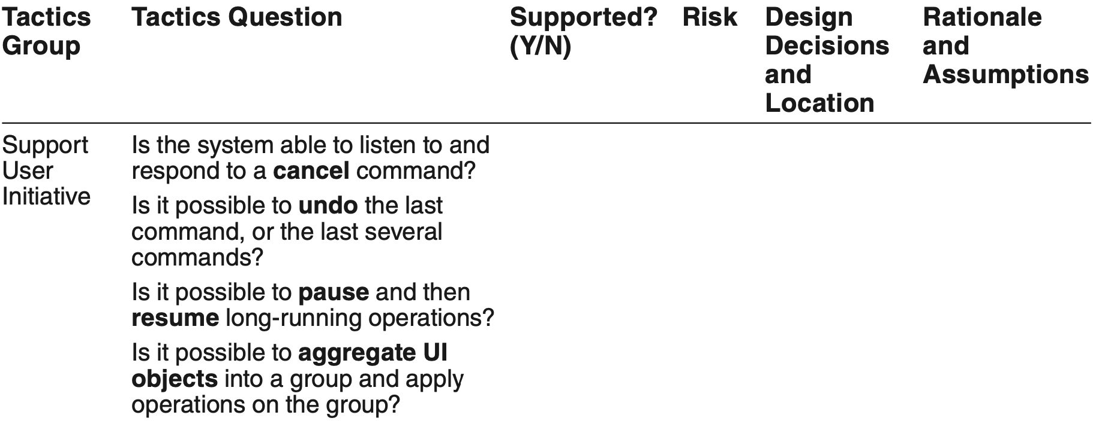
Tactics-Based Questionnaire for Usability

Slide 15
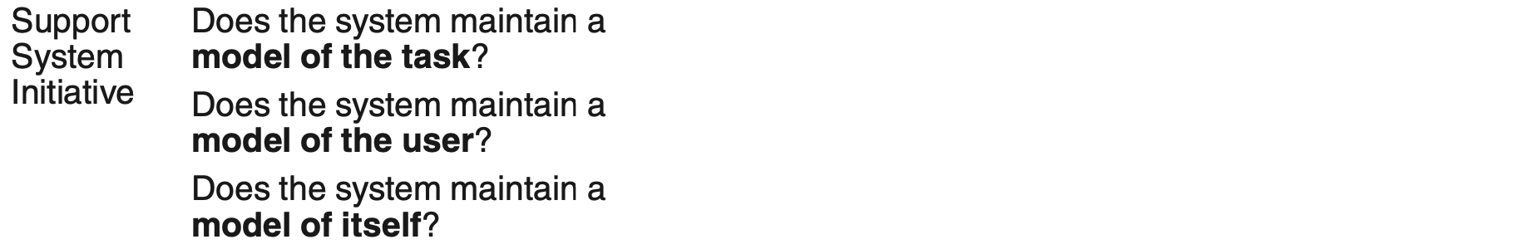
Tactics-Based Questionnaire for Usability

Slide 16
Model-View Controller Pattern
MVC is likely the most widely known pattern for usability.
This pattern is focused on separating the model—the underlying “business” logic of the system—from its realization in one or more UI views.
The model sends updates to a view, which a user would see and interact with.
User interactions are transmitted to the controller, which interprets them and sends operations to the model, which changes its state in response.
The reverse path is where the model might be changed and the controller would send updates to the view.

Slide 17
Model-View Controller Pattern Benefits
Benefits:
Because MVC promotes clear separation of concerns, changes to one aspect of the system, such as the layout of the UI (the view), often have no consequences for the model or the controller.
Additionally, because MVC promotes separation of concerns, developers can be working on all aspects of the pattern relatively independently and in parallel. These separate aspects can also be tested in parallel.
A model can be used in systems with different views, or a view might be used in systems with different models.

Slide 18
Model-View Controller Pattern Tradeoffs
Tradeoffs:
MVC can become burdensome for complex UIs, as information is often sprinkled throughout several components.
For simple UIs, MVC adds up-front complexity that may not pay off in downstream savings.
MVC adds a small amount of latency to user interactions.

Slide 19
Observer Pattern
The observer pattern is a way to link some functionality with one or more views. This pat- tern has a subject—the entity being observed—and one or more observers of that subject.
Observers need to register themselves with the subject; then, when the state of the subject changes, the observers are notified.

Slide 20
Oberver Pattern Benefits
This pattern separates some underlying functionality from the concern of how, and how many times, this functionality is presented.
The observer pattern makes it easy to change the bindings between the subject and the observers at runtime.

Slide 21
Observer Pattern Tradeoffs
The observer pattern is overkill if multiple views of the subject are not required.
The observer pattern requires that all observers register and de-register with the subject.
If observers neglect to de-register, then their memory is never freed, which effectively results in a memory leak. In addition, this can negatively affect performance, since obsolete observers will continue to be invoked.
Observers may need to do considerable work to determine if and how to reflect a state update, and this work may be repeated for each observer.

Slide 22
Memento Pattern
The memento pattern is a common way to implement the undo tactic. This pattern features three major components: the originator, the caretaker, and the memento.
The originator is processing some stream of events that change its state (originating from user interaction).
The caretaker is sending events to the originator that cause it to change its state.
When the caretaker is about to change the state of the originator, it can request a memento—a snapshot of the existing state—and can use this artifact to restore that existing state if needed, by simply passing the memento back to the originator.

Slide 23
Memento Pattern Benefits
The obvious benefit of this pattern is that you delegate the complicated process of implementing undo, and figuring out what state to preserve, to the class that is actually creating and managing that state.
In consequence, the originator’s abstraction is preserved and the rest of the system does not need to know the details.

Slide 24
Memento Pattern Tradeoffs
Depending on the nature of the state being preserved, the memento can consume arbitrarily large amounts of memory, which can affect performance.
In some programming languages, it is difficult to enforce the memento as an opaque abstraction.

Slide 25
Summary
Architectural support for usability involves both allowing the user to take the initiative in circumstances such as cancelling a long running command, undoing a completed command, and aggregating data and commands.
To predict user or system response, the system must keep a model of the user, the system, and the task.

